Slide 1
The Phoenix Project
Usage – Germaine Cornélissen
© 2007 Germaine G Cornelissen-Guillaume. Copying and distribution of this document is permitted in any medium, provided this notice is preserved.
www.phoenix.tc-ieee.org

Slide 2
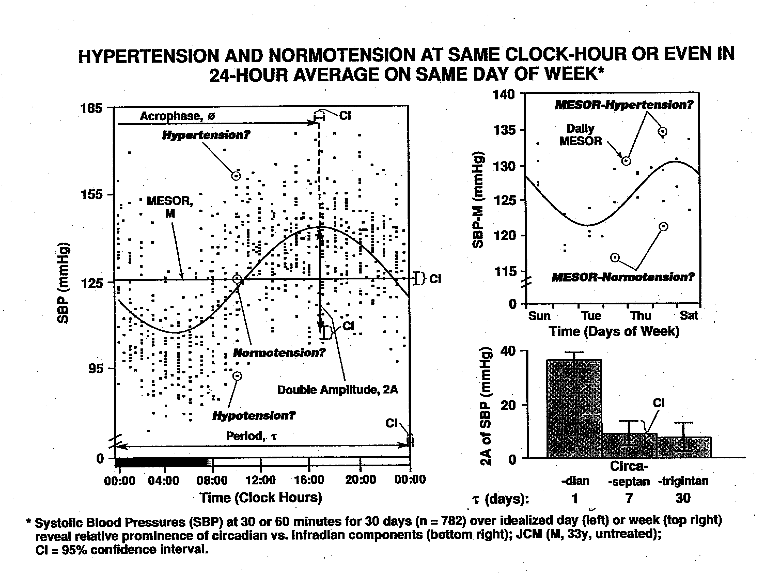
Problem: Blood pressure is highly variable (from moment to moment, from one day to another, …). Are fixed limits such as 140/90 mmHg (systolic/diastolic BP) warranted?

Slide 3
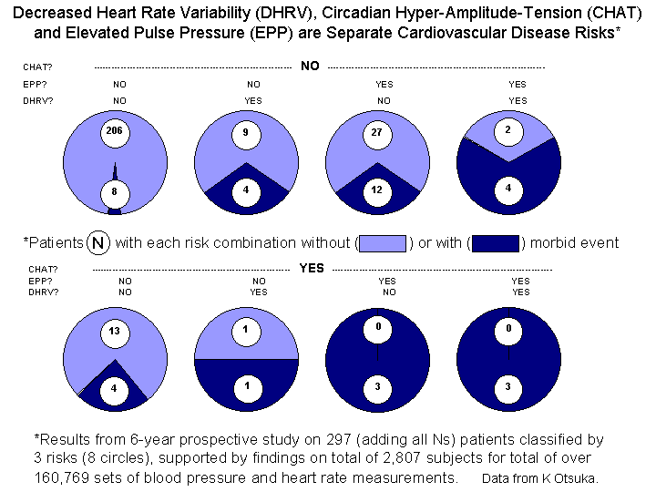
BP variability is not trivial: Abnormal variability in blood pressure and/or heart rate is associated with an increased vascular disease risk, even in the absence of “hypertension”. Abnormalities include:
1. a decreased standard deviation of HR
2. an elevated pulse pressure (SBP-DBP)
3. an excessive circadian BP variation (CHAT)
4. an odd timing of the circadian BP rhythm

Slide 4
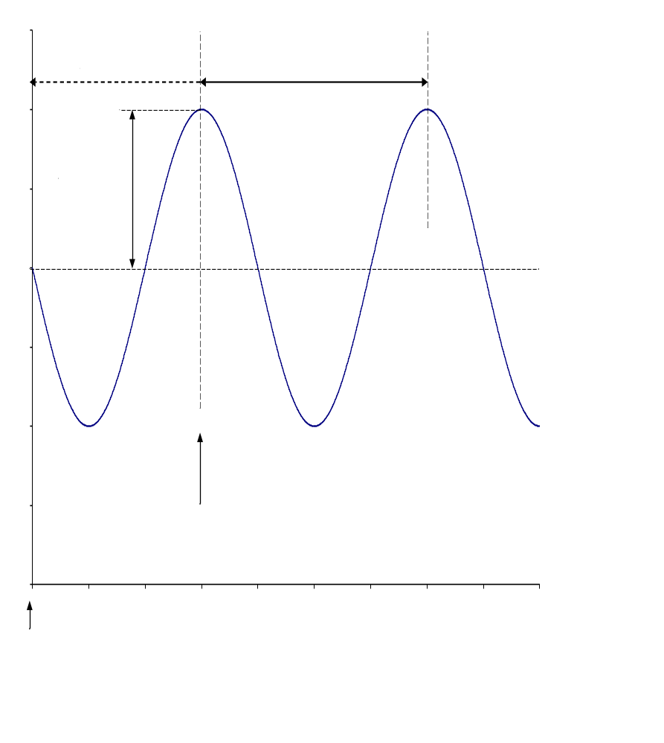
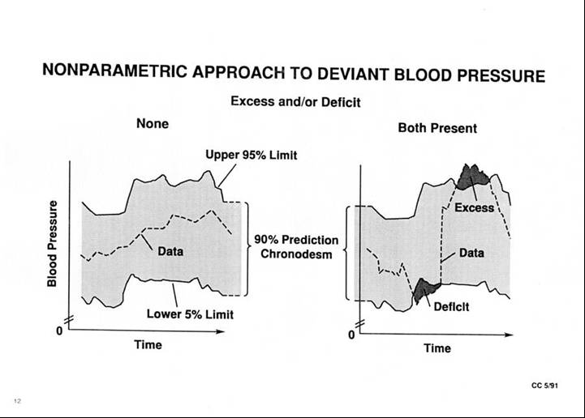
Sphygmochron Analysis:
Data are analyzed parametrically (to assess the circadian charcateristics) and non-parametrically (to check for BP/HR excess or deficit), using reference limits that are time-specified and further qualified by gender and age.

Slide 5
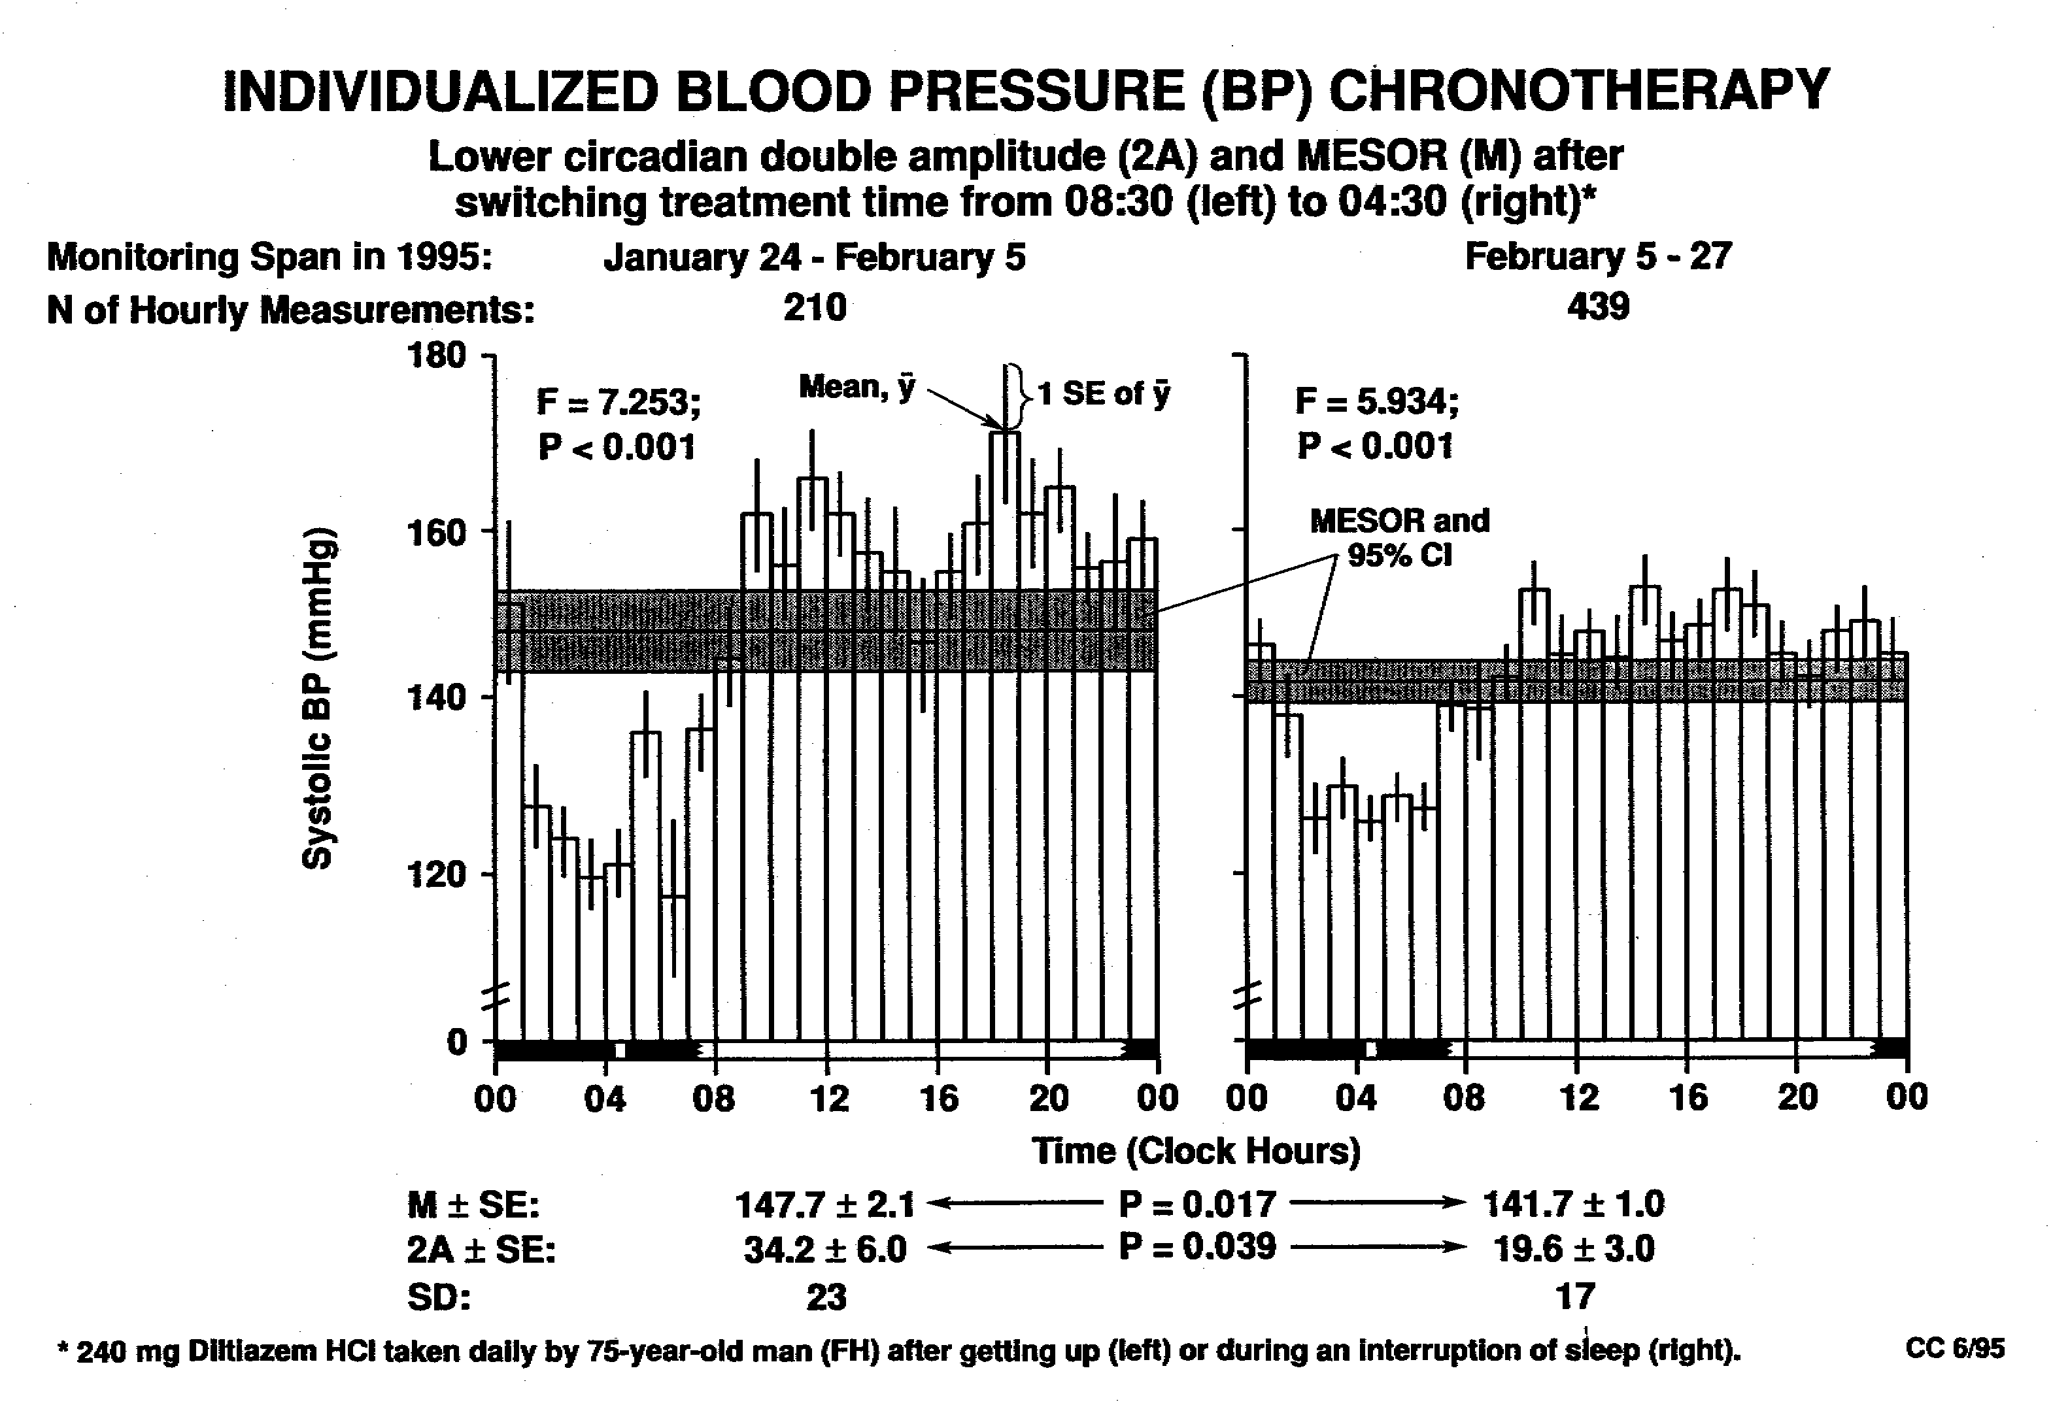
Treatment:
Certain BP/HR abnormalities can be treated by selecting the appropriate medication and a suitable time of administration. For instance, reducing CHAT is associated with better outcomes.

Slide 6
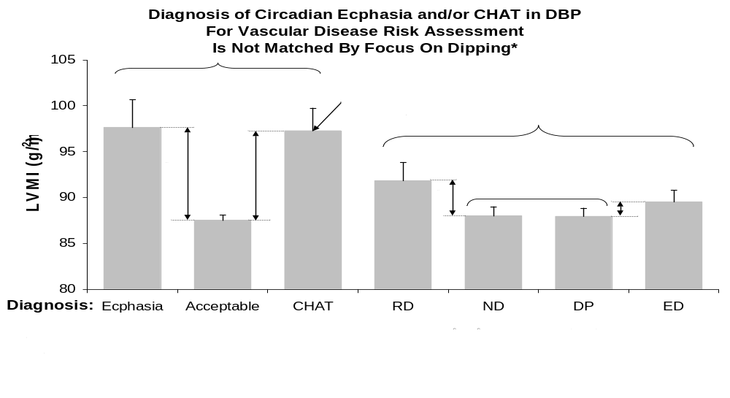
Merit of chronobiologic approach
Higher predictive value of the circadian amplitude and phase interpreted in the light of gender-and age-specified norms as compared to day-night ratio.

Slide 7
Summary
Blood pressure is highly variable.
Abnormal BP/HR variability is not trivial as it is associated with increased vascular disease risk.
Parametric and non-parametric endpoints are interpreted in the light of norms that are specified as a function of circadian stage, gender, and age.
Certain BP/HR variability disorders can be treated and their treatment is associated with improved outcomes.
A chronobiologic approach relying on the circadian amplitude and phase interpreted in the light of time-, gender-, and age-specified norms, has better predictive value than day-night ratios.

